Slide 1


Intelligent Symptom-Based Disease Diagnosis and Medication Guidance
This presentation introduces a software program designed to assist users in disease detection and medication advice based on symptoms they input. The system processes user-provided symptoms, searches a comprehensive medical database, and identifies potential diseases.
It also delivers personalized information on recommended treatments, medicines, and evaluates the severity of the identified disease. This tool aims to improve preliminary self-assessments and support healthcare professionals with detailed symptom-disease-medication linkages.
by Charan Teja

Slide 2
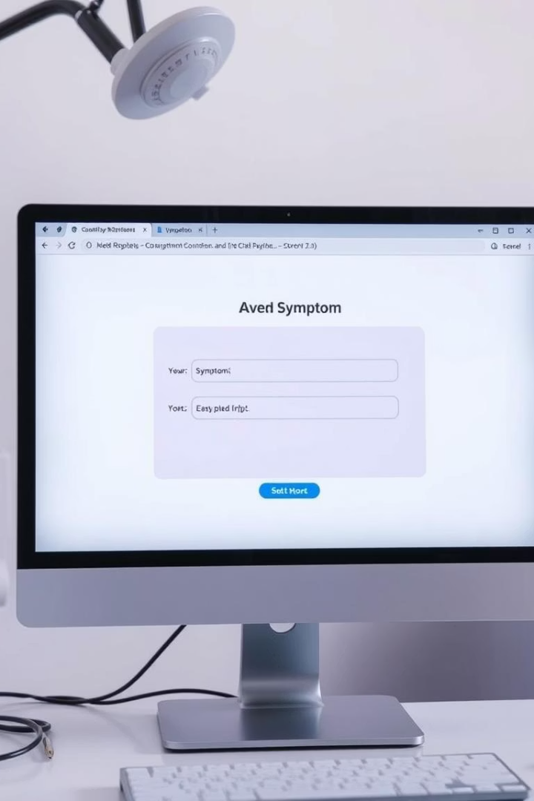
User Input and Symptom Collection Interface
Symptom Entry
Data Validation
Users enter their symptoms in a clear, guided interface that accepts natural language descriptions and selects from predefined symptom lists.
The program checks inputs for completeness and relevance, prompting users to refine or add details for accuracy in diagnosis.
Accessibility Features
Interface accommodates various users including those with disabilities, ensuring inclusive symptom entry for all.

Slide 3
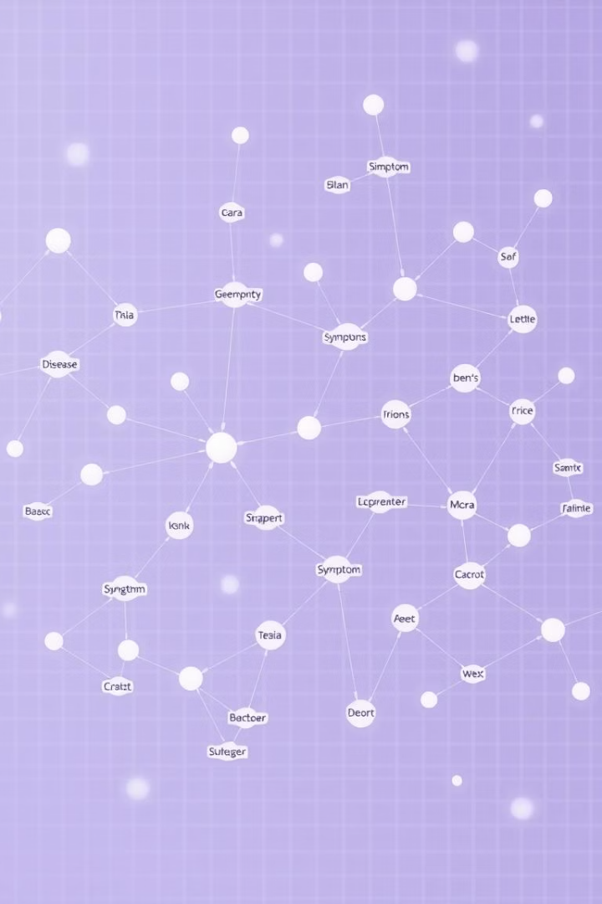
Symptom Analysis and Disease Identification Algorithm
Symptom Mapping
Disease Matching
The program maps user symptoms to known clinical symptom profiles using advanced pattern recognition and natural language processing.
It calculates likelihood scores to suggest possible diseases, ranking them by probability and relevance.
Continuous Learning
Machine learning models improve accuracy by integrating new clinical data and user feedback over time.

Slide 4
Medication Recommendation Based on Diagnosis
Drug Database Integration
Personalized Prescriptions
Safety Warnings
The program accesses an extensive pharmacological database to match diseases with appropriate medications.
Recommendations consider individual factors like allergy history, age, and coexisting medical conditions.
Displays critical warnings about drug interactions, side effects, and dosage guidelines.

Slide 5
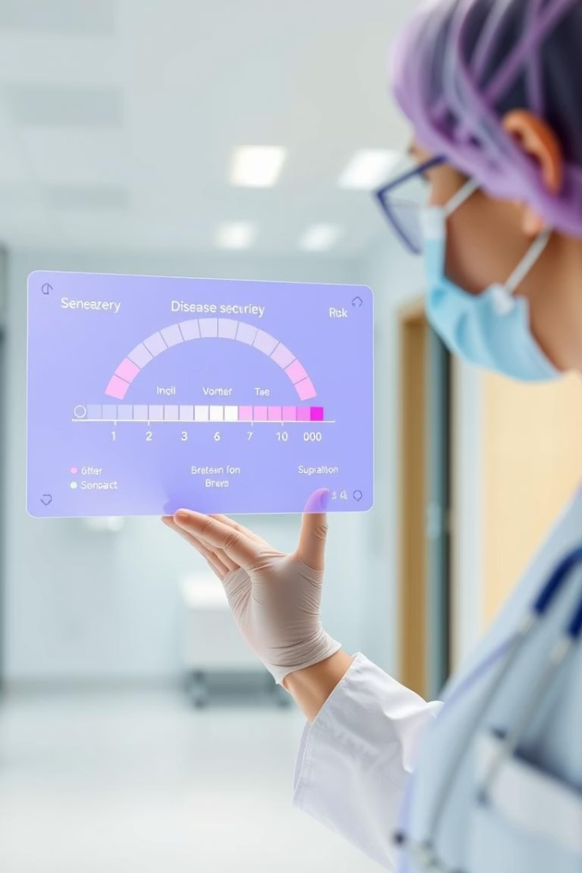



Assessing Disease Severity and Harmfulness
Symptom Severity Rating
Risk Level Alerts
Progression Forecast
Quantifies symptom intensity using clinical scales integrated in the system.
System highlights diseases with high risk or potential complications urgently.
Predicts disease progression trends for informed medical decisions.

Slide 6
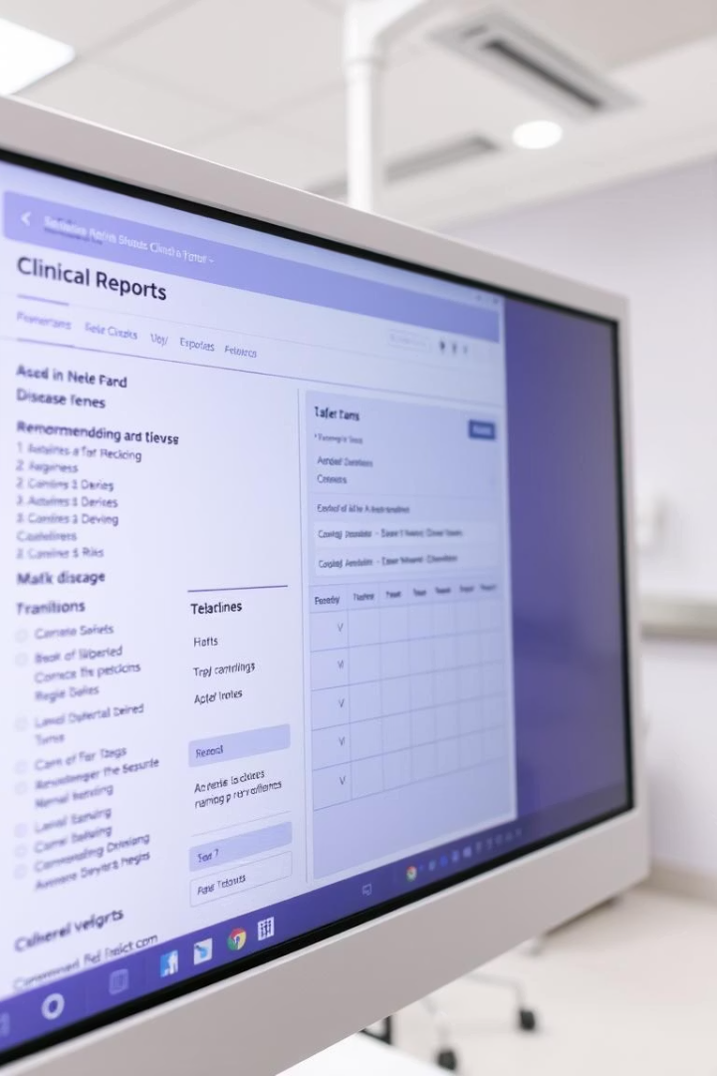



Output Presentation: Diagnosis and Treatment Summary
Diagnosed Conditions
Clear list of potential diseases with confidence scores.
Medication Guidelines
Detailed medication schedules and usage instructions.
Health Risk Summary
Summary of the disease impact level and urgent care indicators.

Slide 7
Technical Architecture and Data Flow
Input Layer
1
Captures and normalizes user symptom data.
Processing Engine
2
Performs symptom analysis, disease matching, and medication recommendation.
Output Module
3
Delivers diagnosis, treatment plans, and severity assessments to users.

Slide 8




Future Development and Clinical Integration
Advanced AI Diagnostics
1
Incorporate more complex symptom-disease relationships and rare conditions.
Personal Health Monitoring
2
Integrate wearable device data for real-time symptom tracking.
Clinical Workflow Integration
3
Embed outputs into electronic health records to assist healthcare providers directly.
User Education
4
Provide detailed educational resources aligned with diagnostic results.
This roadmap aims to extend the software from a symptom checker to a comprehensive clinical decision support tool, enhancing patient outcomes and healthcare efficiency.

